Slide 1

EDA MINI PROJECT
BHAVINI SHARMA

Slide 2
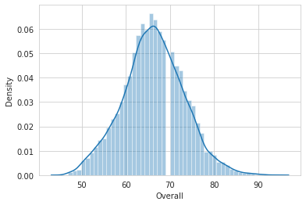
Distribution of Overall rating for all players
RIGHT SKEWED DATA

Slide 3
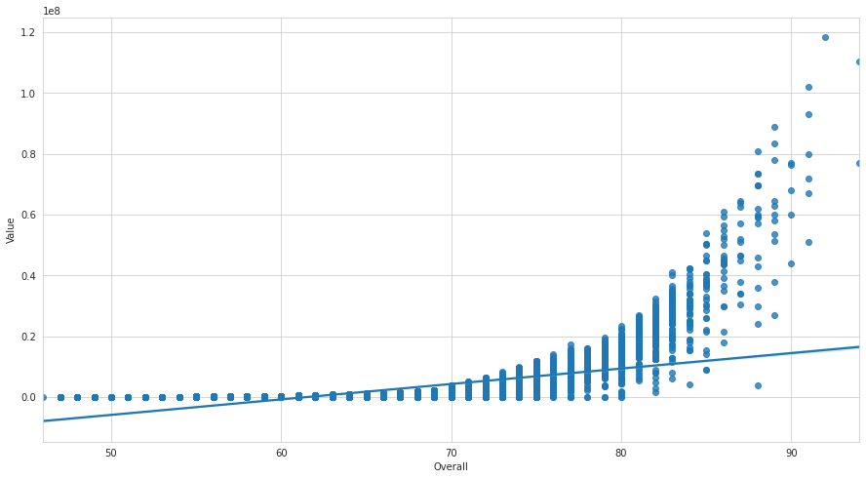
VALUES VS OVERALL RATINGS
As the overall rating increases,
Value of the players tend to
Increase too

Slide 4
Player and different values associated
Average player age:30.65 years
Average Player wage : 205450.0 USD
Most Expensive player: Lionel Messi
Youngest Player: Kangin Lee
Oldest Player: O perez

Slide 5
Average Salaries (In USD)
RF | 740000
ST | 1265000
LW | 1110000
GK | 964000
RCM | 1127000
LF | 606000
RS | 206000
RCB | 1155000
LCM | 922000
CB | 660000
LDM | 398000
CAM | 735000
CDM | 900000
LS | 598000
LCB | 810000
RM | 657000
LAM | 67000
LM | 823000
LB | 601000
RDM | 525000
RW | 795000
CM | 498000
RB | 530000
RAM | 77000
CF | 237000
RWB | 221000
LWB | 171000

Slide 6
Final Players List
L. Messi
Cristiano Ronaldo
Neymar Jr
De Gea
K. De Bruyne
E. Hazard
L. Suárez
Sergio Ramos
T. Kroos
D. Godín
N. Kanté
A. Griezmann
Sergio Busquets
E. Cavani
G. Chiellini
K. Mbappé
J. Rodríguez
P. Aubameyang
Marcelo
P. Pogba
Bernardo Silva
Thiago
Azpilicueta
J. Cuadrado
Luis Alberto
M. Ginter
N. Schulz

